Slide 1
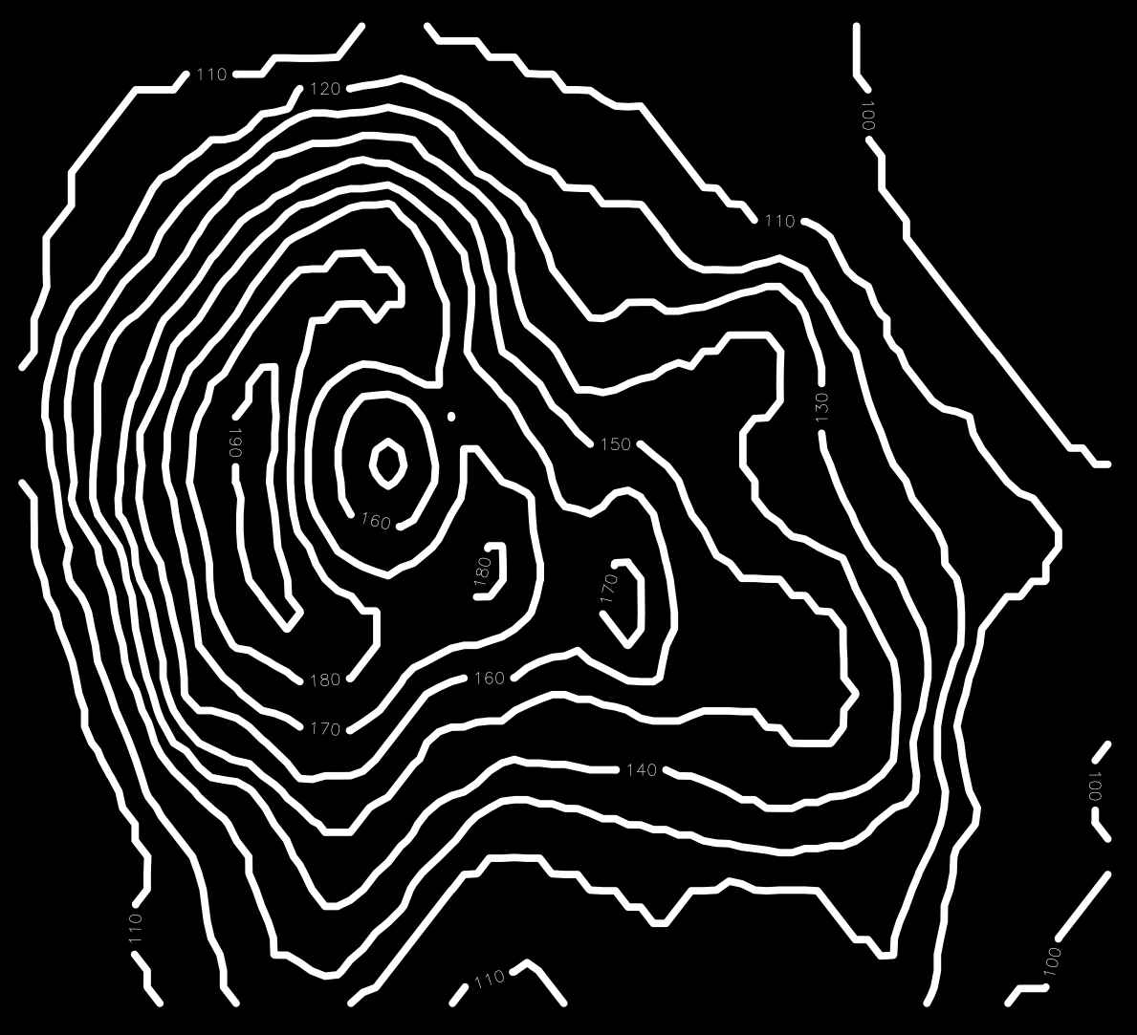
ARS geospatial and environmental epidemiology scoping workshop
Identifying research opportunities and partnerships
Adam Rivers
Mississippi State, MS
May 2024

Slide 2
What is GEERU?
The ARS Geospatial and Environmental Epidemiology Research Unit
A cooperative unit with Mississippi State University
$5,600,000 annual budget, half passed through to MSU.
1 Research Leader, 4 principal investigator scientists, support staff, and postdocs ~15 people
Part of the Animal Health National Program at ARS (103)
A service unit to research and build tools and data to support animal epidemiology and modeling
This is a change from the initial idea of a unit focused on AI, HPC, and Geospatial applications

Slide 3
GEERU’s mandate
“Our capability to rapidly identify, characterize, control, and eradicate new emerging animal pathogens is not well developed. Accordingly, emphasis will be given to filling gaps in our toolbox for predicting the emergence of new pathogens.”
endemic
Objective 1: Develop the data sets and analysis pipelines needed for predicting and modeling the emergence of new pathogens.
Examples
Integrated predictive modeling capability for emerging infectious diseases of animals and the collection of data to support these models.
Comprehensive maps of virus-host interactions required for pathogens to adapt to new hosts.
Identification of molecular determinants that enable emerging pathogens to infect new animal hosts, including humans.
Three-dimensional epidemiological information, integrating metagenomics with climatic and ecological data.
Multi-scale big-data integration models for predicting the emergence of new pandemic pathogens.
Determine quantifiable species-specific transmission parameters of emerging pathogens for modeling and outbreak preparedness.
Methods to rapidly detect and characterize the etiology of new and emerging diseases.
Develop standardized systems for data collection and integrative analysis.
Conduct the molecular characterization of emerging pathogens including phylogenetic analysis and network analysis.
Conduct large-scale genomic sequencing to improve the surveillance of mutations that lead to new pathogenic variants.
Develop integrated techniques from spatiotemporal epidemiology, ecophylogenetics, and distributional ecology.

Slide 4
GEERU as an integrator and multiplier
Data generators
APHIS
NASS
NASA
NOAA
ARS Units
GEERU
Develop tools to:
Disease ecologists and Epidemiologists
University and ARS researchers
Regulatory stakeholders
Create new data types
Lower cost of data acquisition
develop new modeling methods
collect reusable data layers for modeling

Slide 5
GEERU areas and example ideas
New tools and methods for geospatial and environmental epidemiology
Disease detection and characterization
Disease ecology epidemiology modeling
Partnerships
Digital pathogen sequence surveillance
A pipeline for developing low cost paper diagnostics and phone reporting
Development of data layers catalog for geospatial modeling
APHIS groups:
National Veterinary Services Labs
Center for Veterinary Biologics
National Animal Health Monitoring System
National Animal Health Surveillance System
National Preparedness and Incident Coordination
protocols to radically reduce metagenomic surveillance cost
Prediction of Epi parameters from genomics
USGS National Wildlife Health Center
Computational genomics/ML to find alleles for rapid on-farm paper genotyping
Integration with data Providers GEE/ESRI
ARS - NBAF, NADC, NPRC
sensors and imaging for disease detection
prediction of Epi parameters from ML on co-variates
MSU - GRI, ECE, CSE, Vet School
Xenosurveillence

Slide 6
5-year plans at ARS (OSQR)
Units develop at least one 5-year research plan based on a research mandate from the Office of National Programs
Collaborative units write this with their university partner.
This meeting aims to gather information on needs and strengths to create the research plan.

Slide 7
Scoping Workshop Overview
Current methods and work
Evaluating opportunities
Hear from steakholders
What they do
Needs they have
Things they have solved
Modeling
Phylodnamics
Movement and disease
Low-cost surveillance
MSU NACA work
Groups review of opportunities from day 1
discussion
Understanding needs
Understanding current methods and gaps
Developing project areas and evaluating

